Slide 1
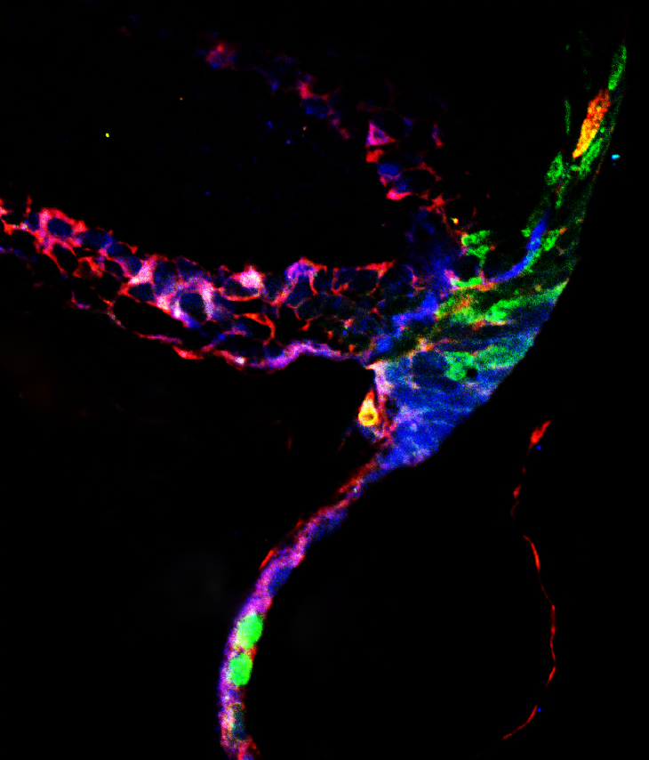
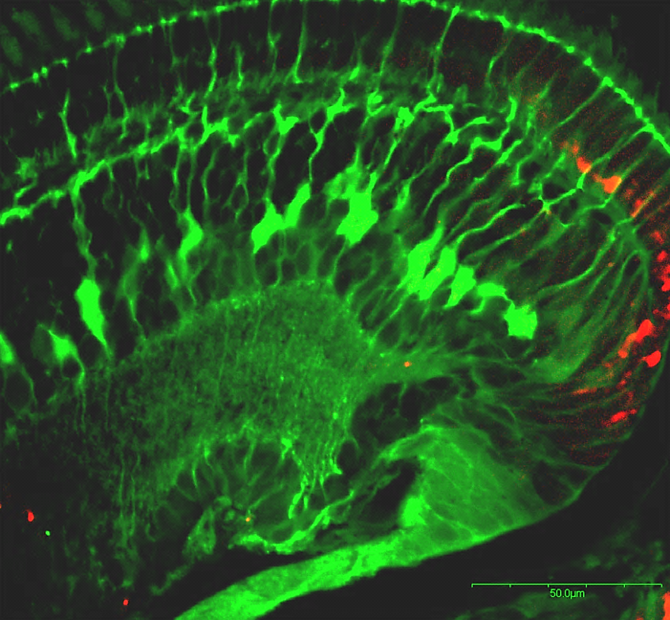
Figure 4
A
B
ONL
CMZ
CMZ-C
CE
CMZ-M
CMZ-P
IdU/CldU Sox2
Sox2 BLBP
C
ONL
D
ONL
CMZ
CMZ
IdU
CldU
E
ONL
F
ONL
CMZ
CMZ
Sox 2
Merge

